Slide 1
TASK QUEUE
By David Lozano

Slide 2
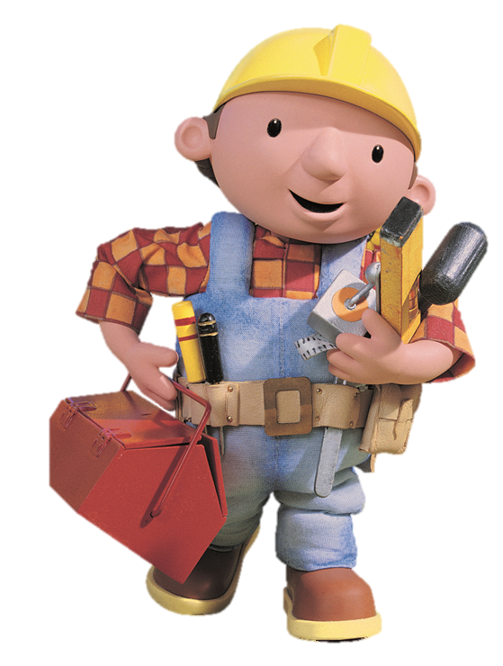
Task
Work handled asynchronously
Task Queue
Push Queue
Pull Queue

Slide 3


Push Queue

Slide 4
Pull Queue
David 32min 29s Metal Slug
Ricard 35min 55s Crysis 3
Yaya 1h 4min Hello Kitty
Roofon 51min 38s Celeste
Cosmo 1h 11min Yoshi Woolly World

Slide 5

Uses in videogames
Chain Commands
Changing the actor of the commands
Redefining Keys
Undo and Redo

Slide 6
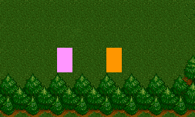

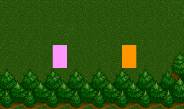



Slide 7
TODO 1
Create a queue of tasks
On this queue we are going to put our commands
USE STD

Slide 8
TODO 2
Create a new class for each task you want to do (one for each direction)

